Slide 1
Quantum Computer
CS 131
Nery Armaz

Slide 2
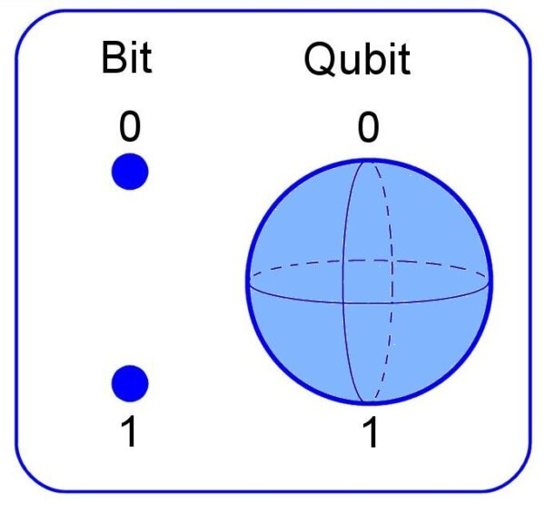
What is a Quantum Computer?
A device that uses certain properties found in quantum mechanics
The basic unit of information is the qubit
Modern technology(computers, phones, etc), uses bits which represent states of 1 or 0
A qubit is like a wave in that it can be a 1 or 0, but it can also be in both states simultaneously
A qubit is a subatomic particle, takes use of the spin of an electron or the orientation of a photon
Due to the unique behavior of a qubit it allows a quantum computer to outperform the most modern supercomputers
Fun fact: 8 bits can represent a single number from 0 - 255. 8 qubits can represent all numbers from 0 - 255 at the same time

Slide 3
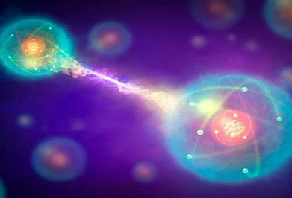
How Quantum Computers Work?
Two properties used in a quantum computer are superposition and entanglement
Superposition is the property for a system to be in multiple states at the same time
For the qubit this allows the simultaneous states of 0 and 1
Precision lasers and microwave beams are used in the quantum computer to put the qubit in a state of superposition
Entanglement is the property for two particles to be linked and dependent on one another despite their location
Entangled particles are dependent on one another so any change to one particle leads to a quick and predictable change to the other
Entangled particles allows for large computations in a quantum computer, that often put strain on normal computers

Slide 4
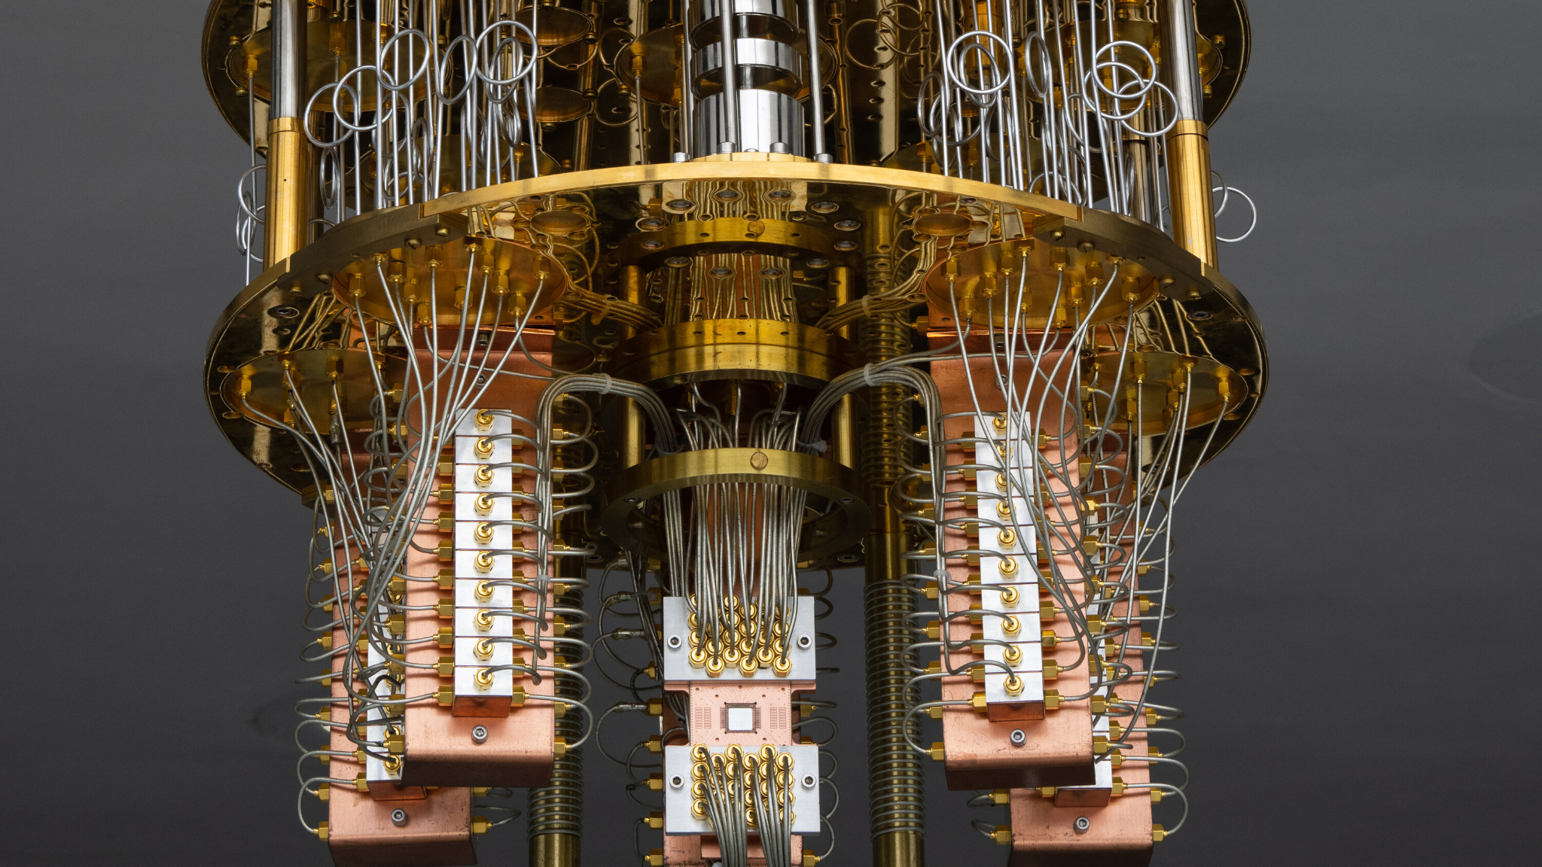
Troubles of the Quantum Computer
IBM Quantum Computer
Quantum computers have potential of more power, but still not as reliable modern computers due to decoherence
Decoherence is when qubits interact with its environment and qubits lose their quantum behavior
Prevents computer from finishing task
Also known as “noise” which could be change in temperature or any vibration
Counter noise through the use of a cryostat/ dilution refrigerator
CPU chip of quantum computer is cooled to a little above absolute zero
Other parts are cooled to temperatures similar to deep space

Slide 5
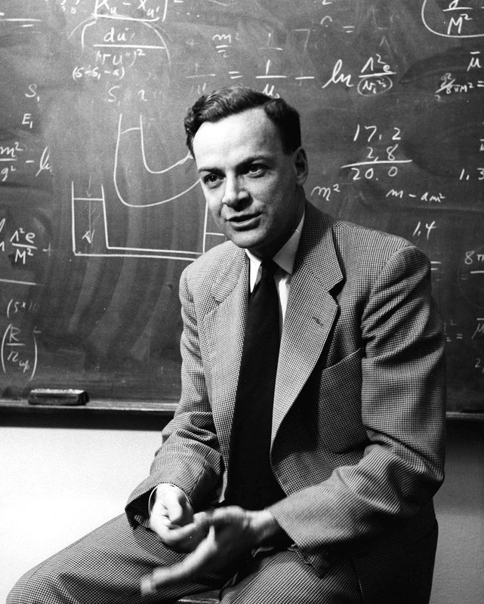
History
1959 - American Physicist Richard Feynman, proposed the idea that as pieces for computers continued to get as small as microscopic scales, then eventually we would start to see the effects of quantum mechanics to build even stronger computers
1985 - David Deutsch of the university of Oxford described the possibility of quantum logic gates that could be implemented in a universal quantum computer
1992 - 1st quantum algorithm formed, not taken serious at the time
1994 - Shor’s algorithm is formed, factored numbers and was respected
1998 - 1st 2 qubit quantum computer is created, very simplistic but demonstrated quantum computation
2000 - 4 qubit computer is created, first model to use a precision laser to entangle the particles
Just a week later the 7 qubit quantum computer is formed

Slide 6
How They Are Being Used Today
Currently being used in: Finance, Automotive, Pharmaceuticals, and AI
Immense power of computer can make better predictions of weather, produce new chemicals, analyze compounds to form new drugs, and simulate the behavior of matter down to the molecular level
Largest supercomputers struggle with these tasks
IBM in specific is working with companies to improve products
Mercedes-Benz is using them to make more efficient electric car batteries by getting accurate simulations of the chemical reactions inside the batteries
ExxonMobil is using them to find the most efficient routes to ship their gas
CERN a european organization for nuclear research is using them to analyze and find new discoveries in the universe

Slide 7
Future of Quantum Computers
Current goal is to reach “quantum supremacy” or where they are used for broad tasks, and demonstrate more practical use over digital computers
Will require more qubits to be held at once, currently only 128 qubits is the max
MIT has built their own quantum computer to study quantum algorithms and information theory
Harvard is focused on being the ones to usher in the next major discovery for quantum computers
New discoveries will lead to new career paths and job opportunities
Plans to eventually form a truly personalized learning experience for all students

